Slide 1
DIGITAL IMAGE PROCESSING · FINAL PROJECT · STAGE 3
Image Denoising:
How the Field Actually Evolved
Not ten papers in order. One technical story: what each method could not do, what the next one changed, and which line of code changed to do it.
THE QUESTION
ANCHOR PAPER
PRESENTERS
REFERENCE
Why did each innovation
have to be invented?
DnCNN — Zhang et al.
IEEE TIP 26(7), 2017
Navid Zare · Ali Ahmadi
Komeil Khodayar
100-slide master deck
submitted separately
brief §3 · full evidence in the master deck
Notes:
Speaker notes. 30s. Say the framing sentence and move. Do not read the meta cards — they answer questions before they are asked.

Slide 2
02
THE SHAPE OF THIS TALK
Four questions we will answer about every method
Each algorithm gets the same four-part treatment, so the comparison between them is structural rather than anecdotal. The methods that were state of the art get a fifth question.
1
2
What could the previous method not do?
What changed technically?
Every innovation in this field was a response to a named, measured failure — usually named by the paper that fixed it, which is what makes this timeline evidenced rather than imposed.
The algorithmic change: a different prior, a different training target, a different operator. Stated precisely enough that you could implement it.
3
4
Which line of code changed?
What did it buy, and what did it cost?
A Before → After from the reference implementations. Contribution → algorithmic change → implementation change → measured improvement, as one chain.
The measured improvement, the applications it opened, and the new limitation it created — because every step in this story created the next problem.
And for the SOTA methods, a fifth: what made it state of the art, on which benchmark and in which years, and why it did not make the others obsolete.
reading — the structure of this presentation
2007
2014
2017
2022
2025
Notes:
Speaker notes. 35s. This slide is a contract with the audience. It also tells the TA exactly what to listen for, which is worth the time.

Slide 3

03
THE PROBLEM
One equation, three unknowns, eighteen years
Given only y, infinitely many splits into x + v are arithmetically valid. Every method in this talk supplies the missing information in a different way — that supplied information is called the prior, and the whole story is about where it lives.
y — what the sensor produced · x — the clean image we want · v — the noise
01
The classical answer writes the prior down as a formula: minimise ½‖y − x‖² + λ·Φ(x). You can read Φ, differentiate it, and argue about it.
02
The deep answer replaces Φ with a tensor of learned weights. You cannot read it, but you can download it and it runs in 60 ms.
03
The self-supervised answer takes the prior partly from the test image itself, so no clean data is needed at all.
04
Where the prior lives, and who writes it, is the single axis this whole talk runs along.
DnCNN17 §I · standard MAP formulation
2007
2014
2017
2022
2025
Notes:
Speaker notes. 55s. This is the only theory slide. Everything else is evolution. Do not derive MAP here — the master deck has it and the audience does not need it to follow the story.

Slide 4
04
GROUND RULES
What 'state of the art' means in this talk
The phrase is used loosely in most presentations. We use it with three qualifiers attached, because that is what makes the SOTA comparison later in the talk meaningful rather than rhetorical.
A SOTA claim needs three things
Which is why there is no single winner
A benchmark and a metric. 'Best denoiser' is meaningless. 'Highest PSNR on BSD68 at σ=25' is a claim you can check.
Different benchmarks measure different capabilities: BSD68 measures average-case Gaussian removal, Urban100 measures long-range self-similarity, SIDD measures real sensor noise.
A comparison protocol. Two papers reporting on the same dataset can still disagree, so wherever a row compares two methods we take both numbers from one table.
A method can lead one and trail another. Restormer, NAFNet and MambaIR each lead a different table today.
Honesty about what is not reported. No paper here states how long it held a position, so this talk does not claim SOTA windows — only the publication date and which table each method leads.
We return to this on slide 36 with the numbers, because 'why are there several SOTAs' is the question this talk is built to answer.
reading, grounded in the benchmark definitions used by DnCNN17, Restormer22, NAFNet22
2007
2014
2017
2022
2025
Notes:
Speaker notes. 38s. Setting this up now means the SOTA comparison later lands as a payoff rather than a hedge.

Slide 5
1
In this part
01
BM3D — the baseline everything is measured against
The Hand-Written Prior
02
WNNM — the classical ceiling
03
Bottleneck 1 — why the era ended
Where the field started: a formula a human wrote, re-solved from scratch for every image.
BASELINE · 2007 – 2014
brief §2
Notes:
Speaker notes. 8s. Just say 'Era one' and move.

Slide 6
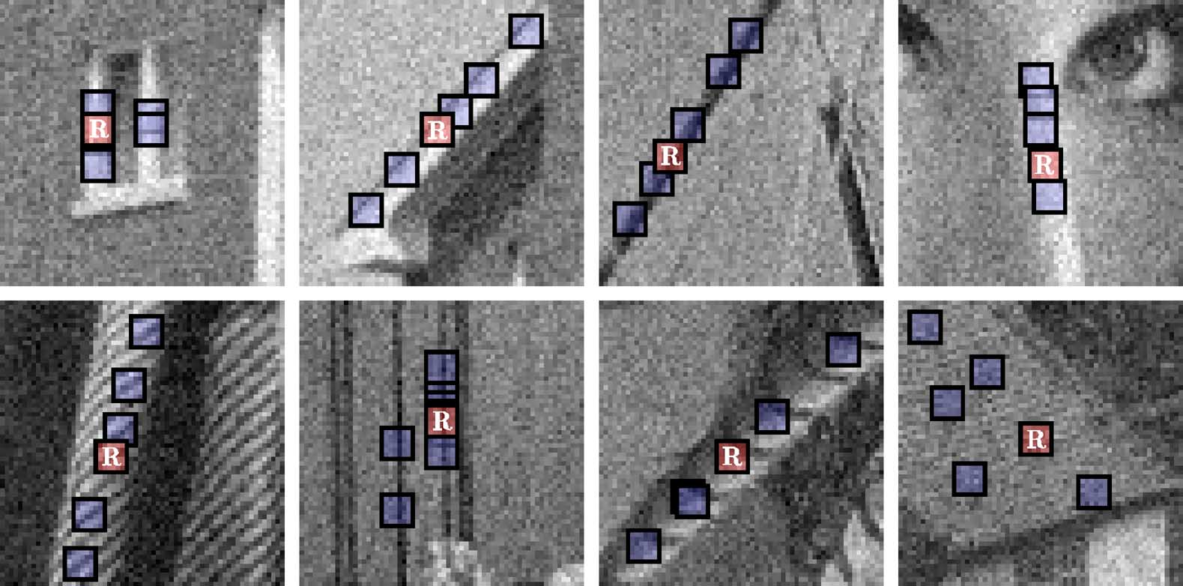
06
BM3D · 2007 · THE BASELINE
The innovation: filter patches together, not alone
Dabov et al., IEEE TIP 2007. Previous transform-domain methods shrank each patch independently. BM3D's innovation is to group similar patches first, creating a third axis along which the signal is nearly constant and the noise is not.
CLASSICAL DIP
Block matching in practice: the reference patch R and the similar patches BM3D groups with it before collaborative 3-D filtering. [BM3D07 · Fig. 2]
What changed
Block-match similar patches into a 3-D stack, transform the stack, hard-threshold, invert, aggregate — then repeat using the cleaner estimate as a Wiener pilot.
Why it works
The paper's own ablation: even a transform that is random apart from the DC loses only 0.1–0.4 dB. The grouping does the work, not the transform. [BM3D07 §V]
BM3D07 §II-C, §V · DnCNN17 Table II, Table IV · baselines in N2N18, N2V19, ZS-N2N23
2007
2014
2017
2022
2025
Notes:
Speaker notes. 72s. The random-transform ablation is the memorable fact — lead with it if pressed for time.

Slide 7
06
BM3D · 2007 · THE BASELINE
· CONTINUED
The innovation: filter patches together, not alone
Impact
BSD68 σ=25: 28.57 dB at 2.85 s per 512×512. Became the reference line every paper for a decade had to beat.
Appears as a live baseline in Noise2Noise (2018), Noise2Void (2019), ZS-N2N (2023) and Restormer (2022) — a seventeen-year-old algorithm is still what new zero-shot methods must beat, because it needs no training data.
Still in use
Applications
The zero-shot comparison in those same papers, and the fallback where there is neither training data nor a GPU. On real sensor noise it still beats an AWGN-trained DnCNN by 1.99 dB. [Restormer22 Table 6]
CLASSICAL DIP
BM3D07 §II-C, §V · DnCNN17 Table II, Table IV · baselines in N2N18, N2V19, ZS-N2N23
2007
2014
2017
2022
2025
Notes:
Continuation of slide 06 (page 2 of 2); speaker notes are on the first page.

Slide 8
07
WNNM · 2014 · BEFORE → AFTER
WNNM vs BM3D — the same grouping, a better estimator
Gu et al., CVPR 2014. WNNM keeps BM3D's non-local grouping and replaces what happens to the group. This is the first clean Before → After in the story, and it is entirely inside one step.
ASPECT | BM3D (2007) | WNNM (2014) | WHY IT MATTERS
Core algorithm | Group patches, shrink in a 3-D transform | Group patches, recover a low-rank matrix | Stacked near-copies are low rank by construction — a stronger structural assumption
Key innovation | Collaborative hard-thresholding | Weighted nuclear norm: wᵢ ∝ 1⁄σᵢ | Large singular values carry the image and are shrunk less; standard NNM shrinks all equally
Implementation change | 3-D DCT + threshold | SVD per patch group + per-value shrinkage, iterated | One transform call becomes an iterated SVD — the entire cost difference
Performance | 28.57 dB · 2.85 s | 28.83 dB · 773.2 s | +0.26 dB for a 271× slowdown
Limitation | Fixed hand-set parameters | Non-convex; still per-image optimisation | Neither can reuse anything learned from one image on the next
Applications | General-purpose, real-time-ish | Offline / quality-critical restoration | The cost makes WNNM impractical for interactive or batch use
CLASSICAL DIP
This row is the whole argument for what comes next. Seven years of hand-designed priors bought 0.26 dB on BSD68 at σ=25, and the best method became 271× slower than the second best. The era had hit a wall in quality and cost simultaneously.
DnCNN17 Table II, Table IV · WNNM14 §3, Theorem 2
2007
2014
2017
2022
2025
Notes:
Speaker notes. 78s. Point at the highlighted row and say the sentence in the footnote. This is the slide that motivates the entire deep era.

Slide 9
08
BOTTLENECK 1
Why the era ended — stated by the paper that ended it
DnCNN's introduction names the classical era's drawbacks in its own words. Quoting the paper that broke the bottleneck, rather than asserting it ourselves, is what makes this an evidenced timeline.
CLASSICAL DIP
DRAWBACK 1
DRAWBACK 2
The prior is paid for once per image
The prior is written by hand
Prior-based methods involve a complex optimization problem in the testing stage. Nothing learned on image 1 helps image 2. WNNM: 773 s, every time. [DnCNN17 §I]
The models are generally non-convex and involve several manually chosen parameters — block size, thresholds, λ, different values above and below σ=40. [DnCNN17 §I]
DRAWBACK 3
DRAWBACK 4
Its form limits the ceiling
One model per noise level
Performance is inherently restricted to the specified forms of prior. You cannot exceed what your formula can express, however well you tune it. [DnCNN17 §I]
Bridge methods train a specific model for a certain noise level and are limited in blind image denoising. In a real camera, σ is never known. [DnCNN17 §I]
DnCNN17 §I — all four quoted from the paper's introduction
2007
2014
2017
2022
2025
Notes:
Speaker notes. 38s. Fast. These four cards are the setup for DnCNN answering all four at once.

Slide 10
2
In this part
01
TNRD — the bridge nobody skips
The Prior Becomes a File
02
DnCNN — innovation, implementation, impact
03
Bottlenecks 2 and 3
One architecture answers all four drawbacks at once — and creates the two problems the rest of the talk is about.
THE BREAK · 2016 – 2017
brief §3
Notes:
Speaker notes. 8s.

Slide 11
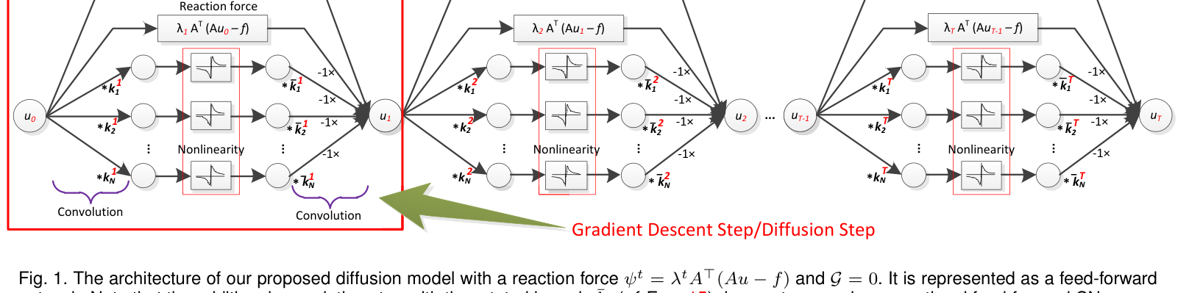
10
TNRD · 2016 · BEFORE → AFTER
Unrolling — the step that made the transition continuous
Chen & Pock, TPAMI. Worth ninety seconds because it is the conceptual bridge: it shows that a classical optimiser and a neural network are the same object viewed differently, which is why the move to deep learning was not a rupture.
THE BRIDGE
The diffusion network unrolled as a feed-forward graph: learned filters, trainable nonlinearity and reaction force applied at every stage. [TNRD16/17 · Fig. 1]
ASPECT | CLASSICAL OPTIMISER | TNRD (UNROLLED) | WHY IT MATTERS
Iteration count | Run to convergence, unbounded | Truncated to a fixed K (usually < 10) | Runtime becomes a constant — the first half of bottleneck 1 is gone
Parameters | Same hand-set rule every iteration | Every stage has its own learned filters and nonlinearities | The prior is no longer one formula; it is K different learned ones
What is learned | Nothing | Filters and influence functions, jointly, from data | Earlier diffusion models fixed the filters and chose the diffusivity
Implementation | while loop to a tolerance | A fixed stack trained by back-propagation | Structurally a CNN — and well-suited for parallel computation on GPUs
TNRD16 §1.2, §2, §3 · DnCNN17 Tables II, IV
2007
2014
2017
2022
2025
Notes:
Speaker notes. 58s. If you are running late, this is the first slide to compress — but do not cut it entirely, the TA may ask how the transition happened.

Slide 12
10
TNRD · 2016 · BEFORE → AFTER
· CONTINUED
Unrolling — the step that made the transition continuous
ASPECT | CLASSICAL OPTIMISER | TNRD (UNROLLED) | WHY IT MATTERS
Performance | WNNM 28.83 dB · 773 s | 28.92 dB · 0.032 s (GPU) | Best quality-per-second of the era
Limitation | — | Still one model per noise level | Blind denoising remains unsolved
Keep this in mind for the next slide. DnCNN derives part of its own justification from a one-stage TNRD — the two are directly connected, not merely adjacent in time.
THE BRIDGE
TNRD16 §1.2, §2, §3 · DnCNN17 Tables II, IV
2007
2014
2017
2022
2025
Notes:
Continuation of slide 10 (page 2 of 2); speaker notes are on the first page.

Slide 13
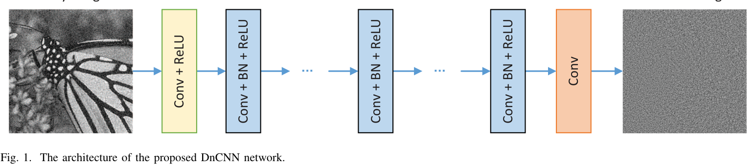
11
DNCNN · 2017 · BEFORE → AFTER
DnCNN vs TNRD — remove the optimiser entirely
Zhang et al., IEEE TIP. TNRD unrolled the optimiser; DnCNN throws away the optimisation heritage and keeps only the network. The technical change is small, the consequence is the largest single step in this story.
DEEP CNN
The DnCNN architecture: Conv(+BN)+ReLU layers predict the residual noise, not the clean image. [DnCNN17 · Fig. 1]
ASPECT | TNRD (2016) | DNCNN (2017) | WHY IT MATTERS
Core algorithm | K diffusion stages, PDE-derived | Plain deep CNN: Conv-BN-ReLU ×17, no pooling | The architecture no longer has to resemble an optimiser at all
What the net outputs | The restored image | The noise — x = y − R(y) | Residual learning: the 'do nothing' solution moves to zero, which is trivially reachable
Key enabler | Learned influence functions | Residual learning + batch normalisation, together | Neither works nearly as well alone — the paper's most-cited empirical finding
Noise levels | One model per σ | DnCNN-B: one blind model, σ ∈ [0, 55] | Drawback 4 solved; no noise estimate needed at test time
DnCNN17 §II-A, §III-A, §III-C, §III-D, Table II, Table IV · TNRD16
2007
2014
2017
2022
2025
Notes:
Speaker notes. 78s. The two highlighted rows are the innovation and the payoff. Say both out loud.

Slide 14
11
DNCNN · 2017 · BEFORE → AFTER
· CONTINUED
DnCNN vs TNRD — remove the optimiser entirely
ASPECT | TNRD (2016) | DNCNN (2017) | WHY IT MATTERS
Performance | 28.92 dB · 0.032 s | 29.23 dB · 0.060 s (blind: 29.16) | +0.6 dB over BM3D at all three noise levels
Applications | Gaussian denoising | One model for denoising + super-resolution + JPEG deblocking | Redefine v and the same network solves three tasks
DEEP CNN
DnCNN17 §II-A, §III-A, §III-C, §III-D, Table II, Table IV · TNRD16
2007
2014
2017
2022
2025
Notes:
Continuation of slide 11 (page 2 of 2); speaker notes are on the first page.

Slide 15
12
DNCNN · THE IMPLEMENTATION CHANGE
The innovation is eight characters
cszn/KAIR, models/network_dncnn.py, by DnCNN's own first author. The architecture is a list comprehension; the contribution is the return statement.
KAIR/models/network_dncnn.py — the whole network
01
Why that one change matters. From ResNet: a mapping close to the identity is hard to optimise. And y is much more like x than it is like v — so learning the image forces the network toward an identity transform, which seventeen ReLU layers have no natural way to express.
1
2
3
4
5
6
7
8
9
10
11
12
13
m_head = B.conv(in_nc, nc, mode='C'+act_mode[-1])
m_body = [B.conv(nc, nc, mode='C'+act_mode)
for _ in range(nb-2)] # ← the entire network
m_tail = B.conv(nc, out_nc, mode='C')
def forward(self, x):
n = self.model(x)
return x-n # ← the contribution
# BEFORE (discriminative CNNs, ~2012-2016):
# return self.model(x) -> learn F(y) = x
# AFTER (DnCNN, 2017):
# return x - self.model(x) -> learn R(y) = v
02
Learning the noise moves the trivial solution to zero, reachable by driving weights toward zero. Same function class, far easier optimisation landscape.
DEEP CNN
03
The synergy, in one sentence. Residual learning strips the image out of the hidden layers, making activations Gaussian-like and content-independent — which is exactly the regime batch-norm's batch statistics assume. Without residual learning, BN has a certain adverse effect on convergence.
04
Where the prior went. Nowhere in this file. It is in the .pth checkpoint this class will load. That is the moment the prior stopped being readable — and started being downloadable.
measured — cszn/KAIR, verbatim · DnCNN17 §II-A, §III-C
2007
2014
2017
2022
2025
Notes:
Speaker notes. 92s. The most important implementation slide in the talk. Point at return x-n, then at the BEFORE/AFTER comment block.

Slide 16
13
DNCNN · WHY IT WAS SOTA
What made it state of the art, and for how long
A SOTA claim with its qualifiers attached: the benchmark, and the margin measured against the ceiling the literature had already established.
+0.6 dB
12 900×
3 tasks
OVER BM3D, ALL THREE Σ
FASTER THAN WNNM AT 512²
ONE MODEL, ONE LOSS
On BSD68. Prior work put the practical ceiling over BM3D at 0.3 dB and the estimated theoretical bound at 0.7 dB — so DnCNN took about 85% of the available headroom. [DnCNN17 §IV-B]
773.2 s CPU → 0.060 s GPU. The device differs and the paper says so; the order of magnitude is the point. [DnCNN17 Table IV]
DnCNN-3 handles denoising, super-resolution and JPEG deblocking by redefining v, beating a specialist baseline on all three. [DnCNN17 §III-D, Table V]
DEEP CNN
01
And it did it blind. DnCNN-B reaches 29.16 dB without being told σ, beating every noise-level-specific competitor in the table. That is drawback 4 closed.
02
Applications it opened: real-time denoising in imaging pipelines; the .pth checkpoint as a shippable artefact; and denoising as a reusable component — a trained denoiser can be dropped into variable-splitting solvers as a general-purpose prior. [SCUNet23 §1]
03
What it was not. On real sensor noise DnCNN was never the leader — it scores 23.66 dB on SIDD. That gap is slide 21's subject.
DnCNN17 §IV-B, Table II, Table IV · SCUNet23 §1
2007
2014
2017
2022
2025
Notes:
Speaker notes. 58s. '85% of the available headroom' is the phrase that makes 0.6 dB sound like what it is.

Slide 17
14
BOTTLENECKS 2 AND 3
What DnCNN broke, and the two bills it left
This slide is the hinge of the whole talk. Everything after it is the field paying off these two debts — and they were paid off by two different communities, independently, and never merged.
Bottleneck 2 — it needs clean data
Bottleneck 3 — it cannot see far enough
The loss is ‖R(y) − (y − x)‖². It requires x.
Receptive field is 35×35 pixels, chosen deliberately to match EPLL, the smallest effective patch size in the field. WNNM's is 361×361.
For fluorescence microscopy, cryo-EM, MRI and astronomy a clean ground truth does not exist and cannot be acquired — you cannot photograph the same cell noiselessly.
DEEP CNN
Visible in DnCNN's own Table III: on Barbara it loses to BM3D by 0.71 dB — the one Set12 image dominated by repetitive texture.
So the most valuable applications of denoising were the ones DnCNN could not serve.
The paper explains it: repetitive images meet well with the non-local similarity prior that a 35×35 convolution stack cannot reach.
→ Answered by the data branch. Presenter 2, slide 19.
→ Answered by the architecture branch. Presenter 2, slide 24.
A limitation visible in 2017, in the winning paper's own results table, that took until 2022 to fix. That is what an honest evolution story looks like.
DnCNN17 §III-A Eq. (1), Table I, Table III · N2V19 §1
2007
2014
2017
2022
2025
Notes:
Speaker notes. 72s. Slow down. Then hand over. Rehearse the handover sentence so it is not awkward.

Slide 18
15
HANDOVER · PRESENTER 2
2018: the field forks, and never merges
Two debts, two communities, two independent answers. Neither branch has adopted the other's advance — which is itself one of the findings of this project, and the source of the open problem we end on.
BRANCH A · BOTTLENECK 2
BRANCH B · BOTTLENECK 3
Change what the network is shown
Change what the network is
Noise2Noise → Noise2Void → ZS-N2N → P2N. The architecture stays almost exactly where DnCNN left it; what moves is the training target. Each paper removes one more requirement until nothing is needed but the noisy image itself.
Restormer, NAFNet, SCUNet, MambaIR. Supervision stays exactly as DnCNN had it — paired data, same loss family. What moves is the operator that replaces the 3×3 convolution.
THE EVIDENCE THEY NEVER MERGED
THE OPEN QUESTION
P2N ships the 2018 network
Nobody has combined them
In the official P2N repository the class is literally named UNet_n2n_un, with the 2018 Noise2Noise channel widths. Seven years, and the backbone is unchanged. [measured]
As far as we found, no published work trains a Transformer or state-space backbone under self-supervised RDC/DCS supervision. We return to this as a concrete proposal on slide 40.
reading — the structural claim of this project · repository: Li-Tong-621/P2N-plus [measured]
2007
2014
2017
2022
2025
Notes:
Speaker notes. 42s. Presenter 2 opens here. This slide is the map for the next twelve minutes — deliver it with energy, it re-engages the room after the handover.

Slide 19
3
In this part
01
Noise2Noise — the statistical result
Removing the Clean Image
02
Noise2Void — the blind spot
03
ZS-N2N and P2N — down to one image
04
What self-supervision costs
BRANCH A · 2018 – 2025
Four papers, each removing exactly one requirement its predecessor could not drop.
brief §4
Notes:
Speaker notes. 8s.

Slide 20
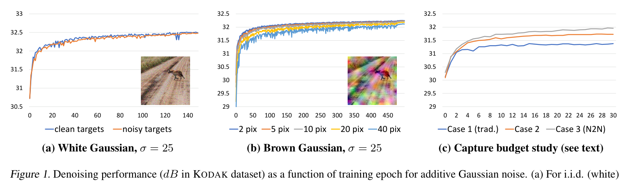
17
NOISE2NOISE · 2018 · BEFORE → AFTER
A theorem worth one conditional
Lehtinen et al., ICML 2018. The most striking ratio in this story: a substantial statistical result whose implementation change is a single branch on which tensor becomes the target.
DATA BRANCH
Noise2Noise's own result: training on noisy targets (orange) tracks clean-target training (blue) almost exactly. [N2N18 · Fig. 1]
N2N18 §2, Eq. (2)–(6), Table 1
2007
2014
2017
2022
2025
Notes:
Speaker notes. 64s. The 0.02 dB number is the punchline — say it last and let it sit.

Slide 21
17
NOISE2NOISE · 2018 · BEFORE → AFTER
· CONTINUED
A theorem worth one conditional
the change, in essence
01
Why it works. L2 regression learns the conditional mean of the target. The paper states the consequence as a triviality: on expectation, the estimate remains unchanged if we replace the targets with random numbers whose expectations match the targets.
1
2
3
4
5
6
7
8
9
# BEFORE — supervised (DnCNN, 2017)
target = clean # requires ground truth
loss = mse(net(noisy), target)
# AFTER — Noise2Noise (2018)
target = second_noisy_shot # ← the entire change
loss = mse(net(noisy), target)
# network, optimiser, schedule, loss family: all unchanged
02
So a second noisy photograph of the same scene is a valid target, because the noise is zero-mean. Given infinite data the solution is identical to clean-target training; for finite data the extra variance shrinks with dataset size.
DATA BRANCH
03
What it does NOT need: no likelihood model of the corruption, no density model of clean images.
04
Measured cost: 0.02 dB. Kodak/BSD300/Set14 at σ=25 — clean targets 31.63, noisy targets 31.61. The clean-data requirement was never actually necessary. [N2N18 Table 1]
N2N18 §2, Eq. (2)–(6), Table 1
2007
2014
2017
2022
2025
Notes:
Continuation of slide 17 (page 2 of 2); speaker notes are on the first page.

Slide 22
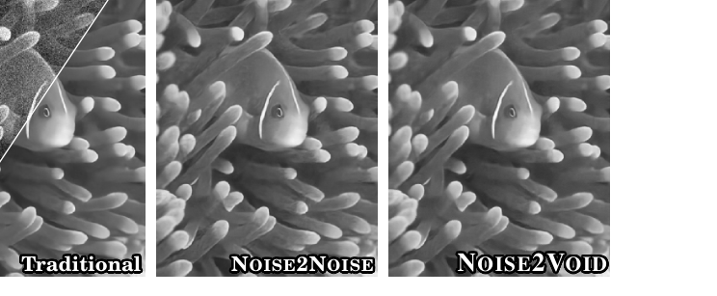
18
NOISE2VOID · 2019 · BEFORE → AFTER
N2V vs N2N — removing the second photograph
Krull et al., CVPR 2019. Noise2Noise still needs two independent shots of one scene, which rules out anything that moves and every archival image. N2V removes that too — and pays for it.
DATA BRANCH
Traditional, Noise2Noise and Noise2Void training schemes side by side, with N2V's single-image blind-spot result on the right. [N2V19 · Fig. 1]
ASPECT | NOISE2NOISE (2018) | NOISE2VOID (2019) | WHY IT MATTERS
Requires | Two noisy shots per scene | One noisy image. That is all. | Applicable to any archive, any moving subject, any single acquisition
Key innovation | Corrupted target with matching mean | Blind-spot receptive field | Prediction for pixel i uses its neighbourhood except pixel i
Why it cannot cheat | Target is independent of input | Noise is conditionally pixel-wise independent, so neighbours carry no information about nᵢ | The identity solution becomes unreachable by construction
N2V19 §3.1, §3.4, §3.5, §4.1, Fig. 4 · N2N18 Table 1
2007
2014
2017
2022
2025
Notes:
Speaker notes. 64s. Volunteering the 'worse than BM3D' row before anyone asks is a rigour move. It also sets up the availability argument as your own point rather than a concession.

Slide 23
18
NOISE2VOID · 2019 · BEFORE → AFTER
· CONTINUED
N2V vs N2N — removing the second photograph
ASPECT | NOISE2NOISE (2018) | NOISE2VOID (2019) | WHY IT MATTERS
Implementation change | Swap the target tensor | Replace the centre pixel with a random neighbour; score the loss only there | A masking trick, not an architecture — any standard CNN acquires the property
Performance (BSD68 σ=25) | 28.86 dB | 27.71 dB | −1.15 dB, and 0.88 dB below BM3D — the cost is real and the paper does not hide it
Applications | Burst photography, rendering | Cryo-TEM, fluorescence microscopy, cell tracking | Domains where the paper's own figure captions the ground truth column does not exist
DATA BRANCH
The honest framing, and the one to use if challenged. Self-supervision is not a quality technique, it is an availability technique. Where clean data exists, supervision wins by 1.35 dB. Where it does not, the comparison is not 27.71 against 29.23 — it is 27.71 against nothing at all.
N2V19 §3.1, §3.4, §3.5, §4.1, Fig. 4 · N2N18 Table 1
2007
2014
2017
2022
2025
Notes:
Continuation of slide 18 (page 2 of 2); speaker notes are on the first page.

Slide 24
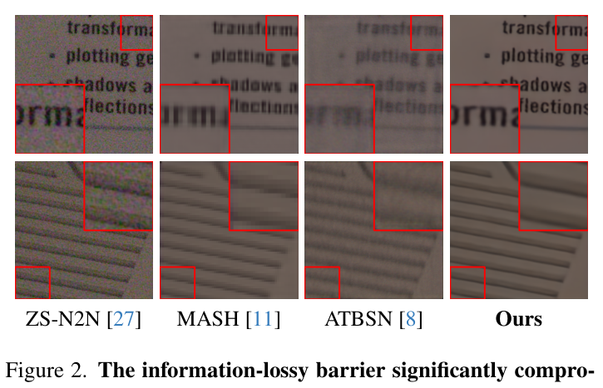
19
ZS-N2N · 2023 · P2N · 2025
Down to one image, then down to no sacrifice
The branch finishes by removing the last two requirements. Compressed into one slide because the pattern is now familiar — each paper removes exactly one thing.
DATA BRANCH
The information-lossy barrier made visible: ZS-N2N, MASH and ATBSN all lose fine structure that P2N's renoise-and-agree supervision keeps. [P2N25 · Fig. 2]
 | ZS-N2N (2023) | P2N (2025)
Requirement removed | The training set. No corpus, no pretraining. | The information loss itself.
Key innovation | A pair downsampler: two fixed diagonal filters split one image into a noisy pair with similar signal and independent noise. | RDC — renoise the model's own output with + and −, giving y⁺ and y⁻ at full resolution. DCS — train the two denoised results to agree.
Implementation change | Two fixed stride-2 convolutions; a 20 000-parameter two-layer net fitted to that one image; residual + consistency loss. | Three forward passes per step, on tensors that do not exist until the model has run once. Output compared against output, not against a target.
ZS-N2N23 §3, §4 · P2N25 (CVPR 2025) · repository measured
2007
2014
2017
2022
2025
Notes:
Speaker notes. 58s. Do not try to explain both methods fully. Deliver the footnote — it is the takeaway.

Slide 25
19
ZS-N2N · 2023 · P2N · 2025
· CONTINUED
Down to one image, then down to no sacrifice
 | ZS-N2N (2023) | P2N (2025)
Why it is not just a new loss | It is a new input construction. | Same: a loss scores a fixed prediction against a fixed target. P2N changes what goes in, how many passes, and which pair is compared.
Cost paid | Half the spatial resolution during training; 1–2 K gradient steps per image. | Three passes per step; still per-image test-time optimisation.
Applications | Single archival images, one-off scientific captures; ~1 min on CPU vs Self2Self's 1.2 h on GPU. | Self-supervised denoising where masking artefacts are unacceptable.
DATA BRANCH
The through-line: the network never moved, the target did. Clean image (2018) → second copy (2019) → training set (2023) → information loss (2025). Four papers, four requirements removed, one U-Net throughout.
ZS-N2N23 §3, §4 · P2N25 (CVPR 2025) · repository measured
2007
2014
2017
2022
2025
Notes:
Continuation of slide 19 (page 2 of 2); speaker notes are on the first page.

Slide 26
4
In this part
01
The evidence for bottleneck 3
Replacing the Convolution
02
Restormer — attention on a different axis
03
NAFNet — delete the mechanisms
04
SCUNet and MambaIR
BRANCH B · 2021 – 2024
Why there are several SOTAs
05
The other debt: a 35×35 receptive field, and three competing operators that fix it.
brief §4
Notes:
Speaker notes. 8s.

Slide 27
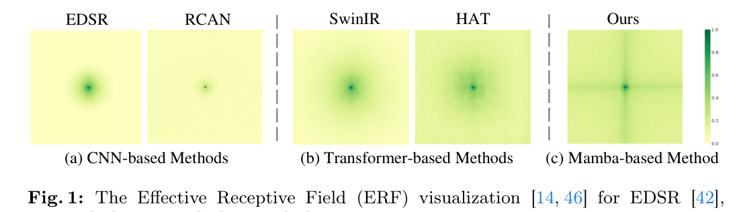
BOTTLENECK 3 · THE RECEIPT
21
One number proves the receptive field is the problem
Identical models, identical table, identical noise level. The only thing that changes is the dataset — and the gain changes by a factor of five.
ARCHITECTURE
Effective receptive field: CNNs stay tightly local, Transformers spread further, the Mamba-based backbone activates the widest field. [MambaIR24 · Fig. 1]
+0.39 dB
+1.98 dB
−0.71 dB
BSD68, Σ=50 · DNCNN → RESTORMER
URBAN100, Σ=50 · SAME TWO MODELS
BARBARA, Σ=25 · DNCNN VS BM3D, 2017
Ordinary natural images, little long-range repetition. Five years of architecture research buys almost nothing.
Photographs of buildings — windows and railings repeating across hundreds of pixels. Five times the gain, on the dataset made of repetition.
The same phenomenon, visible five years earlier in DnCNN's own results, on the one Set12 image dominated by repetitive texture.
Restormer22 Table 4 · DnCNN17 Table III, Table I
2007
2014
2017
2022
2025
Notes:
Speaker notes. 56s. This is the strongest analytical slide in the talk. It is your own reading of published numbers, which is what 'synthesis' means in the grading criteria.

Slide 28
21
BOTTLENECK 3 · THE RECEIPT
· CONTINUED
One number proves the receptive field is the problem
01
What this proves. The architecture branch did not make denoising uniformly better. It made denoising better specifically where non-locality matters — which is exactly the capability a 3×3 convolution stack structurally lacks.
02
Why depth cannot fix it. Receptive field grows linearly with depth: (2d+1)². Reaching WNNM's 361×361 the DnCNN way needs about 180 layers. The fix had to be a different operator, not more of the same one.
ARCHITECTURE
Provenance: the 0.39-versus-1.98 comparison is our own analysis of published values, both taken from Restormer's Table 4 so the protocol is identical. Say computed from Table 4 if challenged.
Restormer22 Table 4 · DnCNN17 Table III, Table I
2007
2014
2017
2022
2025
Notes:
Continuation of slide 21 (page 2 of 2); speaker notes are on the first page.

Slide 29
22
RESTORMER · 2022 · BEFORE → AFTER
Attention becomes affordable by changing one axis
Zamir et al., CVPR 2022. Standard self-attention costs O(W²H²) — a 256×256 image needs a 4.3-billion-entry attention matrix, against 196 tokens for a ViT. Restormer's innovation is to attend over channels instead of pixels.
Restormer/basicsr/models/archs/restormer_arch.py — Attention.forward
01
One einops pattern is the entire complexity claim. Putting pixels on the last axis makes q @ k.transpose(-2,-1) a C×C matrix — 48×48 whether the image is 256² or 4000×3000. Cost becomes linear in pixels.
1
2
3
4
5
6
7
8
9
10
11
# BEFORE — spatial attention (ViT / SwinIR)
# 'b c h w -> b head (h w) c' -> q@kT is (HW x HW)
# 256x256 -> 65,536 x 65,536
# AFTER — Restormer MDTA
q = rearrange(q,'b (head c) h w -> b head c (h w)',
head=self.num_heads) # ← pixels on the LAST axis
k = rearrange(k, ...); v = rearrange(v, ...)
q = F.normalize(q,dim=-1); k = F.normalize(k,dim=-1)
attn = (q @ k.transpose(-2,-1)) * self.temperature
# -> (C/head x C/head). At level 1: 48 x 48, any image size
02
Is it really global? Honestly: not pairwise-pixel. Every channel is computed from every pixel, so channel statistics carry image-wide information; the paper says global relationships are implicitly modelled and never claims otherwise.
ARCHITECTURE
03
The depth-wise convolutions are load-bearing, not decoration. Removing qkv_dwconv costs 0.15 dB on Urban100 σ=50 — more than most architecture papers gain in total. [Restormer22 Table 7]
04
Why SOTA: first method past 40 dB on both SIDD and DND; leads Urban100 at every noise level; 3.14× fewer FLOPs and 13× faster than SwinIR. Published at CVPR 2022; how long it holds those tables is not something any source states.
measured — swz30/Restormer, verbatim · Restormer22 §1, §3.1, Tables 4, 6, 7
2007
2014
2017
2022
2025
Notes:
Speaker notes. 74s. 'Show me where the attention is actually linear' is the single most likely code question in the defence. Point at the rearrange.

Slide 30
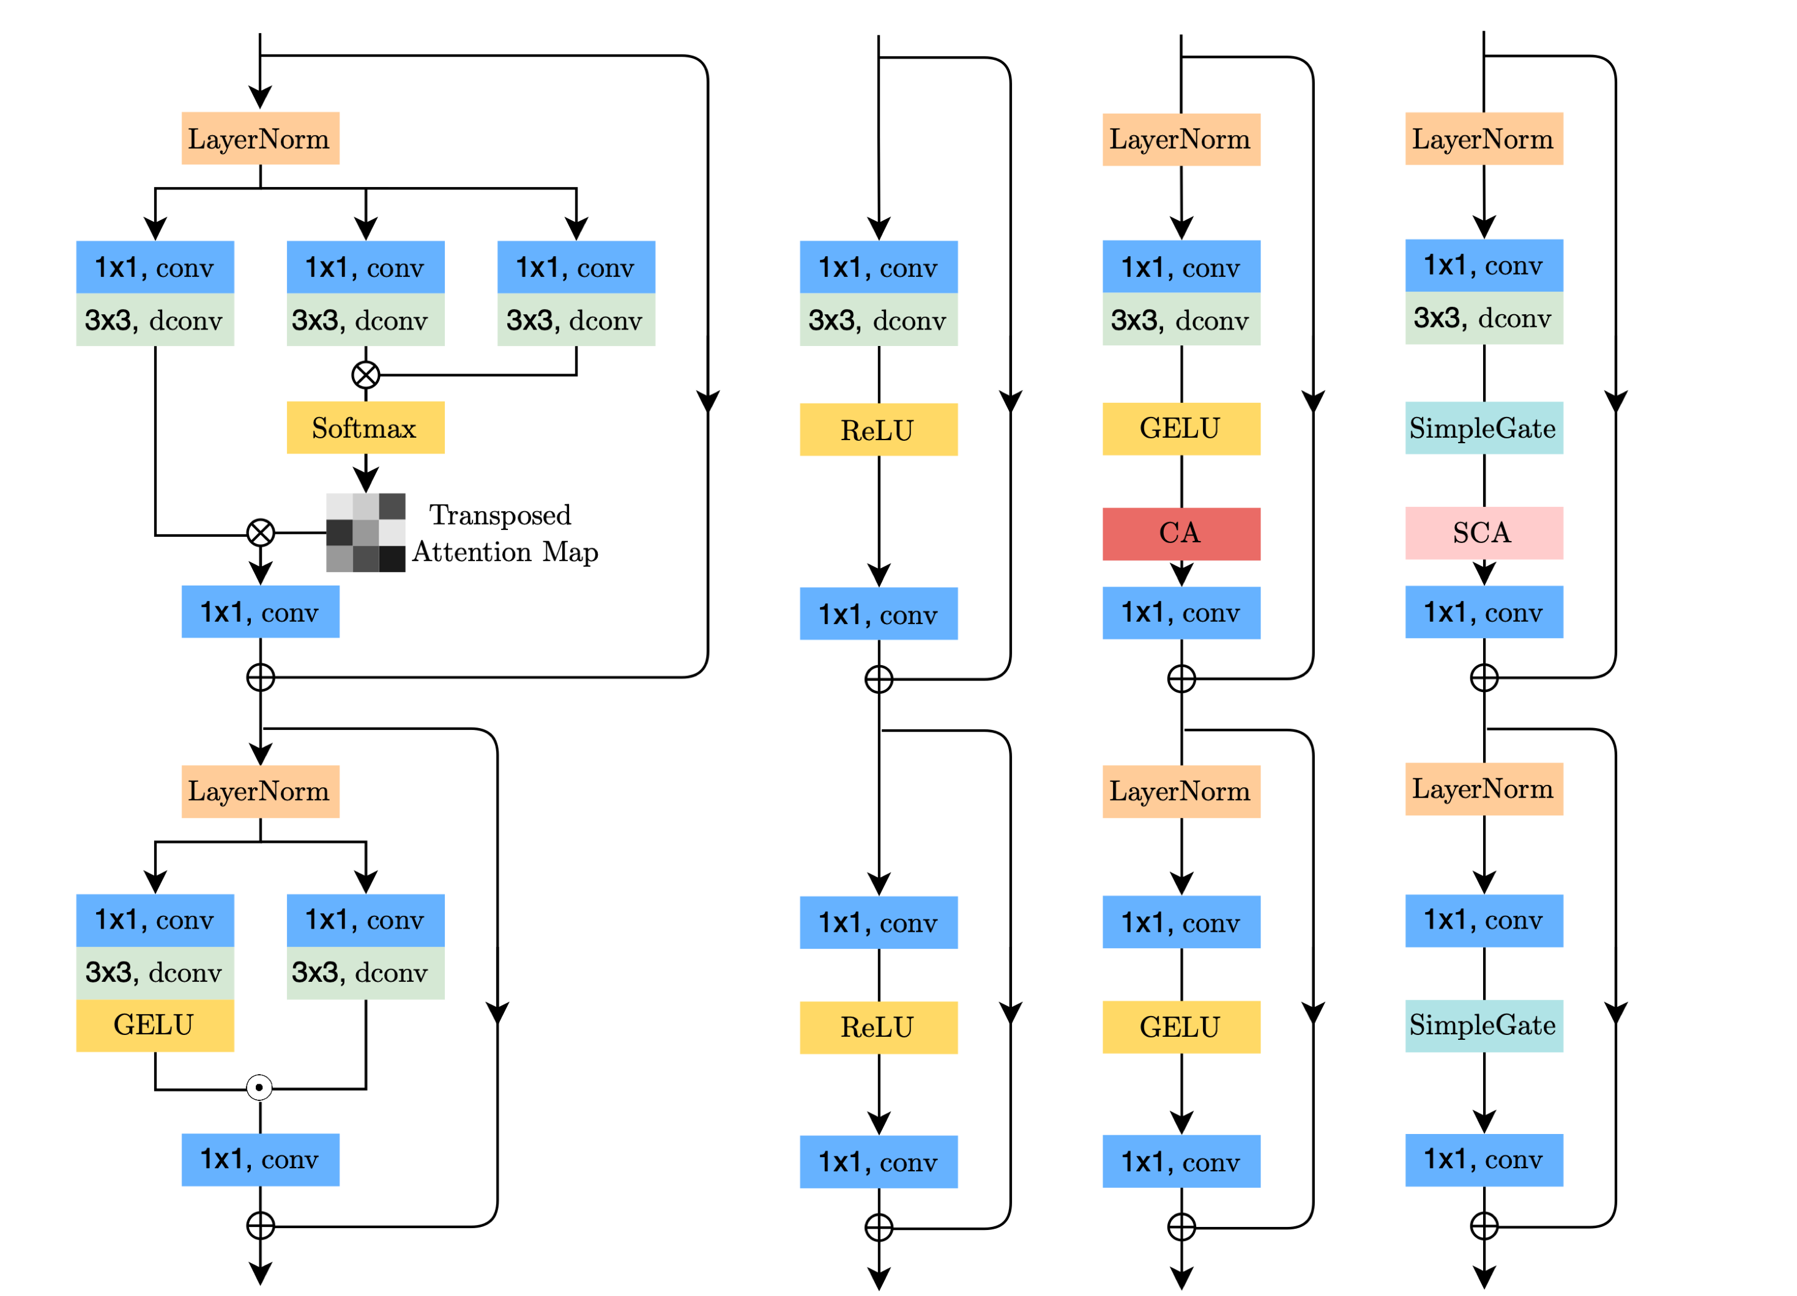
23
NAFNET · 2022 · BEFORE → AFTER
The paper that asked whether any of it was necessary
Chen et al., ECCV 2022. While everyone added mechanisms, NAFNet removed them and scored higher. Its derivation is the most elegant reasoning in the modern half of this story.
ARCHITECTURE
The lineage NAFNet derives in one figure: the transformer block simplified step by step down to SimpleGate and SCA. [NAFNet22 · Fig. 3]
measured — megvii-research/NAFNet, verbatim · NAFNet22 §4, §5, abstract
2007
2014
2017
2022
2025
Notes:
Speaker notes. 74s. The LayerNorm finding is the intellectually honest highlight of the whole talk. Do not skip it.

Slide 31
23
NAFNET · 2022 · BEFORE → AFTER
· CONTINUED
The paper that asked whether any of it was necessary
NAFNet/basicsr/models/archs/NAFNet_arch.py
01
The derivation. GELU is a special case of a gated linear unit with f, g = identity and σ = Φ. But a GLU itself contains nonlinearity and does not depend on σ — f(X)⊙g(X) is nonlinear because a product of two linear maps is not linear. So delete the activation; the gate already supplies it.
1
2
3
4
5
6
7
8
9
10
11
12
# BEFORE — GELU, then a gate
# GELU(x) = 0.5x(1+tanh[sqrt(2/pi)(x+0.044715x^3)])
# CA(X) = X * sigmoid(W2 relu(W1 pool(X)))
# AFTER — SimpleGate: the gate IS the nonlinearity
def forward(self, x):
x1, x2 = x.chunk(2, dim=1)
return x1 * x2 # ← replaces GELU entirely
# AFTER — SCA: no sigmoid, no relu
self.sca = nn.Sequential(nn.AdaptiveAvgPool2d(1),
nn.Conv2d(c, c, 1))
02
Apply the same argument to channel attention and both its nonlinearities vanish too. Result: no Sigmoid, no ReLU, no GELU, no Softmax anywhere — the first work demonstrating that the nonlinear activation functions may not be necessary for SOTA computer vision methods.
ARCHITECTURE
03
Both simplifications improved the score. SimpleGate beats GELU (+0.08), SCA beats CA (+0.03) on SIDD.
04
The uncomfortable finding in their own ablation: the largest single gain is LayerNorm, +0.44 dB — because it stabilises training at a 10× larger learning rate. A large share of reported architectural progress in restoration is optimisation progress wearing a costume.
Why SOTA: 40.30 dB on SIDD — the highest real-noise result in our comparison — at less than half the previous best's compute. Published at ECCV 2022. And by far the simplest code to maintain.
measured — megvii-research/NAFNet, verbatim · NAFNet22 §4, §5, abstract
2007
2014
2017
2022
2025
Notes:
Continuation of slide 23 (page 2 of 2); speaker notes are on the first page.

Slide 32
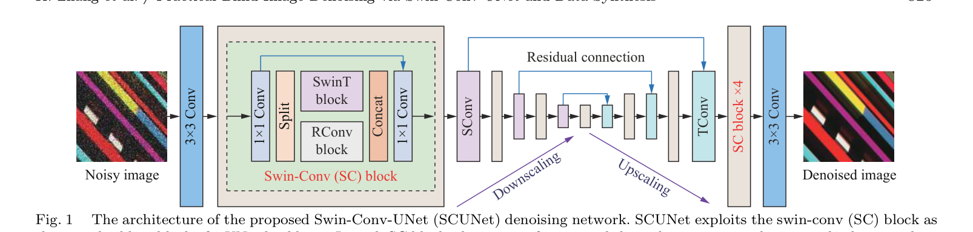
24
SCUNET · 2023 · MAMBAIR · 2024
Two more answers — one architectural, one not about architecture at all
The branch does not end with Transformers. MambaIR proposes a different operator again; SCUNet argues the operator was never the problem.
ARCHITECTURE
The Swin-Conv-UNet pipeline: swin-conv blocks combine local and non-local modelling on the way down and back up a UNet backbone. [SCUNet23 · Fig. 1]
 | MAMBAIR (2024) | SCUNET (2023)
The claim | Attention is quadratic; windowing surrenders globality. Borrow a selective state-space model — global receptive field at linear cost. | The benchmark is the problem. A model trained on AWGN performs poorly for most of real images due to noise assumption mismatch.
Technical change | S6 recurrence with input-dependent B, C, Δ. Dual form: recurrent (unbounded memory) for reach, convolutional for parallel training. | Keep local and non-local priors in parallel — split the feature map, half to a Swin block, half to a residual conv block.
MambaIR24 §3.1, §3.2, Tables 1, 2, 6 · SCUNet23 abstract, §1, §3.1, §3.2 · measured
2007
2014
2017
2022
2025
Notes:
Speaker notes. 58s. The MambaIR import failure is a genuine deployment result nobody reports — worth mentioning, it shows you ran the code.

Slide 33
24
SCUNET · 2023 · MAMBAIR · 2024
· CONTINUED
Two more answers — one architectural, one not about architecture at all
 | MAMBAIR (2024) | SCUNET (2023)
Implementation change | Flatten the image to a sequence; four-directional scan; add a local conv (fixes local pixel forgetting) and channel attention (fixes redundancy). | The dataloader becomes the contribution: Gaussian, Poisson, speckle, JPEG, and sensor noise synthesised through a real inverted ISP, plus resizing and double degradation.
Why SOTA / where | Best DND result, 40.04 dB — by 0.01 dB. Leads super-resolution on Manga109 ×2 by 0.41 dB over SwinIR. | Not top of any AWGN table — and does not need to be. 9.663 M parameters, smallest of the four, built to survive real photographs.
Cost / limitation | Will not import without compiled CUDA extensions. Its own changelog records that published thop complexity figures were wrong. [measured] | Its abstract still concedes a general-purpose blind real denoiser remains unsolved.
ARCHITECTURE
MambaIR24 §3.1, §3.2, Tables 1, 2, 6 · SCUNet23 abstract, §1, §3.1, §3.2 · measured
2007
2014
2017
2022
2025
Notes:
Continuation of slide 24 (page 2 of 2); speaker notes are on the first page.

Slide 34
5
In this part
01
The SOTA comparison table
Why There Is No Single Winner
02
Why several coexist
03
Applications and trade-offs
04
Open problems and proposals
The question this talk was built to answer, now with the numbers behind it.
SYNTHESIS
brief §6
Notes:
Speaker notes. 8s.

Slide 35
26
SOTA COMPARISON
Four current methods — each leads a different table
Every row names the benchmark and the metric, because a claim without those is not checkable. All quality figures are reproduced from published tables; parameters and CPU latency are our own measurements.
METHOD | LEADS ON | FIGURE | PUBLISHED | WHAT DISTINGUISHES IT | COST
NAFNet (2022) | SIDD — real sensor noise | 40.30 dB | ECCV 2022 | No attention, no activation functions at all; simplest code | 116.0 M params · 1.90 s CPU
Restormer (2022) | Urban100 — long-range structure | 28.33 dB σ=50 | CVPR 2022 | First past 40 dB on both SIDD and DND; channel attention at linear cost | 26.1 M · 10.44 s CPU
MambaIR (2024) | DND — held-out real noise | 40.04 dB | ECCV 2024 | Global receptive field at linear cost via selective state-space scan | Needs compiled CUDA to import
SCUNet (2023) | Blind denoising on synthesised real-world degradation | — | Mach. Intell. Res. 2023 | Competes on the training distribution, not the architecture | 9.7 M · 1.69 s CPU
DnCNN (2017) | Historical — BSD68 Gaussian | 29.23 dB | IEEE TIP 2017 | The reference the whole field was built against | 0.67 M · 1.02 s CPU
BM3D (2007) | Zero-shot — no training data | 28.57 dB | IEEE TIP 2007 | Requires no training data and no GPU; still the zero-shot baseline in N2N18, N2V19 and ZS-N2N23 | No training · 2.85 s
No source states a SOTA window, so this deck does not assert one. The published date is verifiable; which table a method leads is verifiable from the cited comparison. For how long it held that position is not reported by any paper here, and we do not estimate it. Read the Leads on column: these methods are not ranked on one axis — they lead different benchmarks, and those benchmarks measure different capabilities.
NAFNet22 abstract · Restormer22 Tables 4, 6 · MambaIR24 Table 6 · DnCNN17 Table II · measured [Stage 2]
2007
2014
2017
2022
2025
Notes:
Speaker notes. 74s. The centrepiece of the synthesis. Walk the second column, then deliver the footnote.

Slide 36
27
WHY SEVERAL SOTAS
Four reasons the field has not converged on one method
This is the question the professor is most likely to ask, so it gets its own slide rather than a sentence.
REASON 1
REASON 2
The benchmarks measure different things
The cost axes disagree with each other
BSD68 measures average-case Gaussian removal and has saturated — 0.36 dB across five years. Urban100 measures long-range self-similarity. SIDD and DND measure real sensor noise. A method can lead one and trail another without any contradiction.
Our own measurements give three incompatible rankings of the same models: by parameters DnCNN wins; by CPU wall-clock the P2N backbone wins; by real-noise quality NAFNet wins. NAFNet has 4.4× Restormer's parameters and runs 5.5× faster. 'More efficient' is meaningless without naming the metric and the device.
REASON 3
REASON 4
Deployment constraints are not quality constraints
Supervision availability partitions the field
MambaIR leads DND by 0.01 dB and cannot be imported without compiled CUDA extensions. SCUNet leads nothing and is a third of Restormer's size. Which one is 'best' depends entirely on what you are shipping onto what hardware.
Branch A and branch B answer different questions. Where clean pairs exist, supervision wins by 1.35 dB. Where they do not, the self-supervised methods are not worse — they are the only option, and the supervised SOTA is simply unavailable.
Restormer22 Table 4 · NAFNet22 · MambaIR24 · N2V19 §4.1 · measured
2007
2014
2017
2022
2025
Notes:
Speaker notes. 62s. If you only have time for one slide in this section, it is this one. It demonstrates understanding rather than knowledge.

Slide 37
28
APPLICATIONS AND TRADE-OFFS
What you would actually deploy, and why
The honest answer to 'which is best' names the constraint first. Five constraints, five different answers, all current — which is what an unresolved research question looks like when you have to ship something.
IF YOUR CONSTRAINT IS… | DEPLOY | BECAUSE | ACCEPT
Real photos, GPU, paired data | NAFNet | 40.30 dB on SIDD; best accuracy-per-millisecond we measured; simplest code to maintain | 116 M parameters
Repetitive structure, max quality | Restormer | Leads Urban100 at every σ; only method past 40 dB on both real-noise benchmarks | 10.4 s per 256² on CPU
CPU or memory bound | SCUNet | 9.7 M parameters; synthetic-degradation training survives resized and JPEG'd input | Not top of any AWGN table
No clean data exists at all | P2N / ZS-N2N | Microscopy, cryo-EM, astronomy — where ground truth cannot be acquired | Per-image test-time optimisation
No data, no GPU, no dependencies | BM3D | Seventeen years old and still beats AWGN-trained DnCNN on real noise by 1.99 dB | 2.85 s, and a quality ceiling
Denoising is rarely the product. It is preprocessing for detection and segmentation, a plug-and-play prior inside deblurring and super-resolution solvers, and — per DnCNN-3 — a template: redefine v and the same network does super-resolution and JPEG deblocking. [SCUNet23 §1 · DnCNN17 §III-D]
NAFNet22 · Restormer22 · SCUNet23 · P2N25 · ZS-N2N23 · measured
2007
2014
2017
2022
2025
Notes:
Speaker notes. 52s. Never answer 'which would you use' with a single name. Answer with the constraint that decides.

Slide 38
29
OPEN PROBLEMS
What eighteen years did not solve
Each of these is grounded in a documented limitation from the papers themselves or in our own measurements — not speculation.
OPEN 1
OPEN 2
A blind denoiser for real cameras
Fidelity metrics reward blur
SCUNet's abstract states it remains unsolved. Neither synthetic degradation nor SIDD-trained models generalise to an unseen camera with an unseen ISP, and no benchmark currently measures that. DnCNN scores 23.66 dB on SIDD — a 16 dB collapse, not a graceful degradation.
Every loss in the modern field is L1, L2 or PSNR, and all three recover a conditional mean — which is smoother than any plausible clean image. Noise2Noise names the mechanism itself: L2 training results in spatial blurriness. While leaderboards rank by PSNR, the incentive points the wrong way.
OPEN 3
OPEN 4
Nobody agrees what 'efficient' means
The benchmarks have saturated
Three incompatible rankings from our own measurements, and MambaIR's changelog concedes its published complexity figures were wrong. Efficiency claims across papers are close to uncheckable.
BSD68 σ=25 moved 0.36 dB in five years while Urban100 moved five times as much and SIDD moved sixteen decibels. A benchmark that cannot distinguish 2017 from 2022 is no longer measuring what the field works on.
SCUNet23 abstract · Restormer22 Tables 4, 6 · N2N18 §2 · measured
2007
2014
2017
2022
2025
Notes:
Speaker notes. 44s. These four set up the proposals on the next slide — do not linger, the payoff is next.

Slide 39
30
PROPOSAL DIRECTIONS
Four research directions the limitations actually justify
Each is tied to a specific documented gap, states what would change, and names how it would be measured. None of these claims a paper achieved something it did not.
DIRECTION | GROUNDED IN | WHAT WOULD CHANGE | HOW YOU WOULD MEASURE IT
Cross the fork: self-supervised supervision on a modern backbone | Our own finding — no published work trains a Transformer or SSM backbone under RDC/DCS supervision; P2N still ships the 2018 U-Net | Replace UNet_n2n_un with a Restormer or NAFNet block under P2N's RDC/DCS training signal | N2V's own protocol on BSD68 σ=25 and on the cryo-TEM / CTC sets; does the 1.35 dB self-supervision gap shrink?
Cross-ISP generalisation benchmark | SCUNet's abstract: a general blind real denoiser remains unsolved, and no benchmark tests unseen cameras | Train on SIDD, evaluate on DND and a held-out camera; report the drop as the headline number | Δ PSNR between seen and unseen ISP — a metric nobody currently reports
Perceptual objective without losing fidelity | Noise2Noise names L2's spatial blurriness; perceptual losses are common in SR and absent from denoising | Add an LPIPS or no-reference term to NAFNet's PSNR loss and report both axes, not one | PSNR and LPIPS jointly on SIDD — accept a small dB loss for a measured perceptual gain
An efficiency protocol the field can agree on | Three incompatible rankings from our measurements; MambaIR's corrected thop figures | Report parameters, MACs and wall-clock on a named device, with the counting method stated | Reproduce the table across CPU and GPU; the ratio changes are themselves the result
The first row is the one we would pursue. It falls directly out of the structural claim of this project — the two branches have never merged — and it is cheap to test, because both halves already exist as working code.
reading, grounded in P2N25, SCUNet23 abstract, N2N18 §2, MambaIR24 changelog, and our own measurements
2007
2014
2017
2022
2025
Notes:
Speaker notes. 60s. This is the slide that answers 'can you identify a proposal'. The footnote commits to one — have a reason ready for why that one.

Slide 40
31
CONCLUSION
The evolution, in one paragraph
Denoising is the cleanest case study in how computer vision replaced hand-designed priors with learned ones, because here the prior is written down explicitly and you can watch it move.
Four eras, three bottlenecks. Manual prior design ended when DnCNN made the prior a downloadable file. That created two new debts — it needed clean data, and it could only see 35 pixels — and in 2018 the field forked to pay them off separately.
Neither branch has adopted the other's advance. And because three architectures now lead three different benchmarks while none solves real-camera generalisation, the story ends in an open question rather than a winner.
— What the evidence in this talk supports.
reading — the organising claim, carried since Stage 1
Notes:
Speaker notes. 40s. Deliver from memory, slide behind you. Then stop and invite questions — do not trail off.

Slide 41
32
BACKUP · QUESTION INDEX
Where to find the answer to what you are about to be asked
Kept for the Q&A. The full evidence for every claim in this talk is in the 100-slide master deck, indexed here by the question likely to prompt it.
IF ASKED… | ANSWER IN ONE LINE | MASTER DECK
Why is 0.6 dB a big deal? | Practical ceiling over BM3D was 0.3 dB, theoretical bound 0.7 dB — DnCNN took 85% | 10, 37
Why predict noise, not the image? | y is closer to x than to v, so learning the image forces an identity mapping — the hard point in parameter space | 33
Why do RL and BN need each other? | RL makes layer inputs Gaussian-like and content-independent — what BN's batch statistics assume | 34
Why depth 17? | RF = (2d+1)² set to 35×35 to match EPLL, the smallest effective patch size in the field | 35
How can noisy targets work? | L2 learns the conditional mean; the mean of a zero-mean corrupted target is the clean target | 43
Where is Restormer's attention linear? | Attention.forward — the rearrange puts pixels last, so q@kᵀ is C×C not HW×HW | 69
Why is NAFNet faster with more parameters? | 1×1 and depth-wise convs hit optimised GEMM paths; rearrange forces tensor-layout changes | 77
What did the code tell you that the papers did not? | Padding constants differ 8×; SPI cuts parameters and triples latency; MambaIR needs CUDA to import | 75, 77
Which would you deploy? | Name the constraint first — five constraints, five answers, all current | 89
Did you verify the PSNRs yourself? | No. Every quality figure is reproduced from a named published table; only parameters and latency are ours | 81, 93
The rule for the defence: do not put anything on a slide you cannot personally explain. Every claim in this talk traces to a named table in a named paper, or to a measurement whose method is stated.
reading — Q&A index
2007
2014
2017
2022
2025
Notes:
Speaker notes. Not presented. Do not present this slide. Have it open during questions. Print it if you can.

